Slide 1
Hyper, Brev, Medi, Trans
Semester 2 Quiz 2

Slide 2
What is the purpose of Greek and latin?
Know one root, know many words
Know one suffix, know part of speech
Know one prefix, know definition
Know roots, strengthen reading ability
Know vocabulary, strengthen writing ability

Slide 3

Hyper- Over

Slide 4
Using context clues and prior knowledge predict the meaning of the vocabulary word Hyperbole.
The hyperbole in the poem made the extra large title make sense.

Slide 5

Hyperbole(n)- figure of speech, uses over exaggerations to prove a point
Association/Leaf- Write your own example of a hyperbole

Slide 6
Using context clues and prior knowledge predict the meaning of the vocabulary word Hyperactive.
The hyperactive student gave an excellent rendition at the poetry battle.

Slide 7
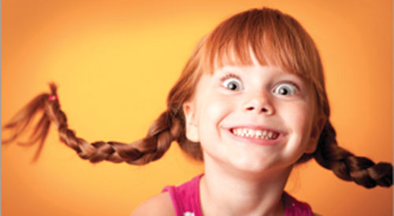
Hyperactive(adj)- displaying exaggerated physical activity
Association/Leaf- write the name of a hyperactive relative.

Slide 8
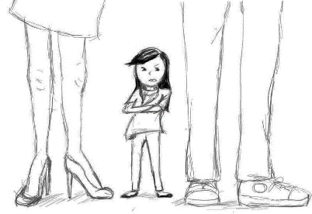
Brev- Short

Slide 9
Using context clues and prior knowledge predict the meaning of the vocabulary word BREVITY.
The brevity of the teacher’s lecture surprised the students.

Slide 10

Brevity: the use of concise and exact words in language
Brevity(adj): the use of concise and exact words
Association: males; they usually just tell you how it is.

Slide 11
Using context clues and prior knowledge predict the meaning of the vocabulary word BRIEF.
The brief verb lecture did not prepare the students for the extensive test.

Slide 12
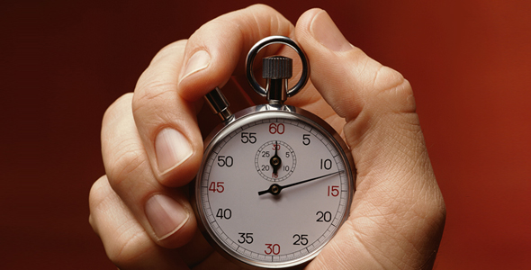
Brief(n or adj): lasting only a short period of time
Brief: lasting only a short period of time
Association: Exploratories
Association: Exploratories

Slide 13
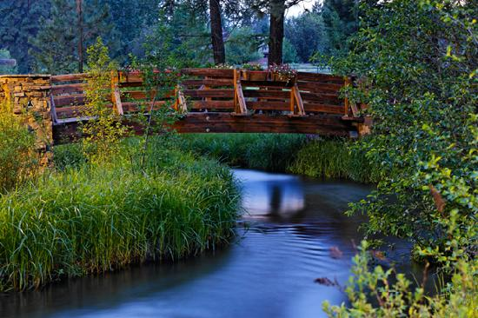
Trans- across

Slide 14
Using context clues and prior knowledge predict the meaning of the vocabulary word TRANSLATE.
The young girl translated the conversation for her foreign grandmother.

Slide 15

Translate-(v) express the sense of (words or text) in another language
Association/Leaf- What careers would need a translator?

Slide 16
Using context clues and prior knowledge predict the meaning of the vocabulary word TRANSFUSION.
After the car accident, the driver needed a transfusion.

Slide 17
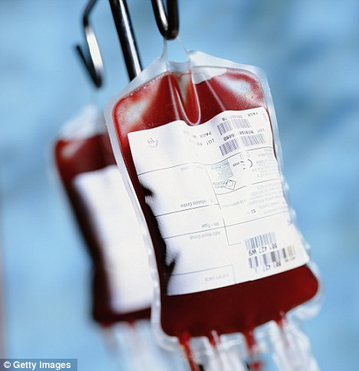
Transfusion- (n) an act of transferring donated blood
Association/Leaf- When would you need a transfusion?

Slide 18
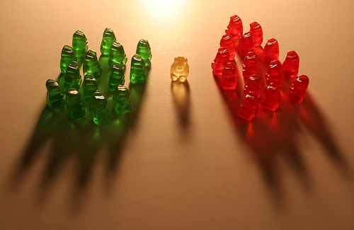
Medi- middle

Slide 19
Using context clues and prior knowledge predict the meaning of the vocabulary word MEDIAN.
Mr. Mathews expected his students to be able to find the median of the test scores.

Slide 20
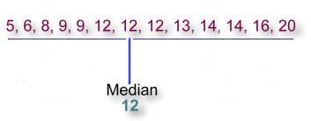
Median (n)-the median value of a range of values.
Association/Leaf- Median often gets confused with mean

Slide 21
Using context clues and prior knowledge predict the meaning of the vocabulary word Mediterranean.
The Mediterranean is an excellent spot for many Europeans to vacation.

Slide 22
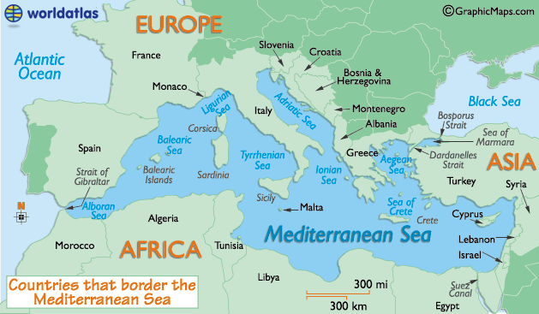
The Mediterranean Sea (n.) is a sea connected to the Atlantic Ocean surrounded by the Mediterranean region and almost completely enclosed by land
Association/Leaf- Have you ever been to the Mediterranean Sea or surrounding countries? Where?

