Slide 1
Greek and Latin Roots
Semester 2-Quiz 1
Tort, Alter, Contra, Se

Slide 2
What is the purpose of Greek and latin?
Know one root, know many words
Know one suffix, know part of speech
Know one prefix, know definition
Know roots, strengthen reading ability
Know vocabulary, strengthen writing ability

Slide 3

Alter- Toeher
Alter-Other

Slide 4
Using context clues and prior knowledge predict the meaning of the vocabulary word Alter ego.
Superman’s alter ego was Clark Kent.

Slide 5
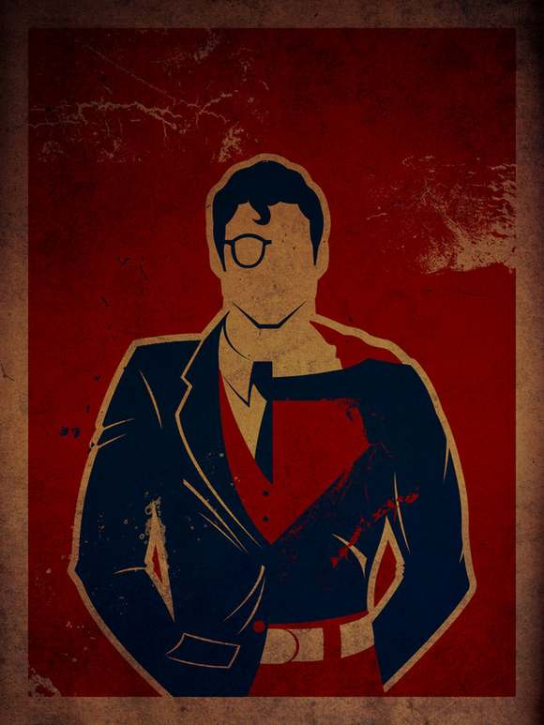
Alter Ego (n)- “Other” “I”-other personality
Association/Leaf- Super Heroes

Slide 6
Using context clues and prior knowledge predict the meaning of the vocabulary word Altruism.
High levels of altruism and empathy are what ultimately motivates

Slide 7

Altruism(N)- the belief of selfless concern and caring for OTHERS
Association/Leaf- nursing homes, animal shelters, missionaries

Slide 8

Contra- Against

Slide 9
Using context clues and prior knowledge predict the meaning of the vocabulary word contradict.
Civil law and common law occasionally overlap or contradict each other.

Slide 10
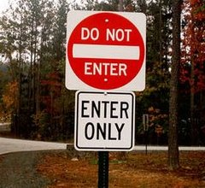
Contradict(V)- “Against” “Speak”
Association/Leaf- Turn to the person next you and describe a time someone contradicted themselves

Slide 11
Using context clues and prior knowledge predict the meaning of the vocabulary word contrary.
Evidence to the contrary was suppressed until the 1990s

Slide 12
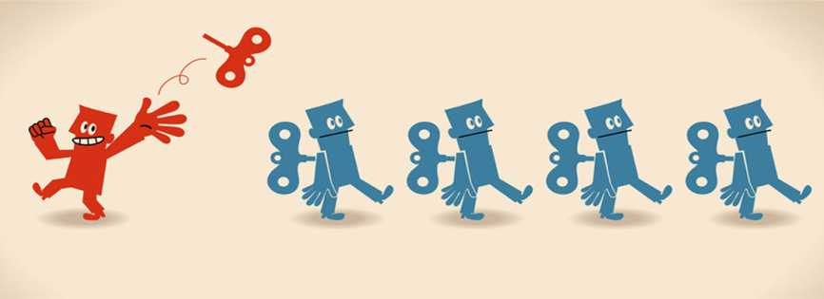
Contrary- opposite in nature, direction, or meaning (noun/adj)
Association/Leaf- write a sentence using contrary as a noun or an adjective

Slide 13

Se-apart

Slide 14
Using context clues and prior knowledge predict the meaning of the vocabulary word secluded.
The student worked better in a secluded corner of the room.

Slide 15
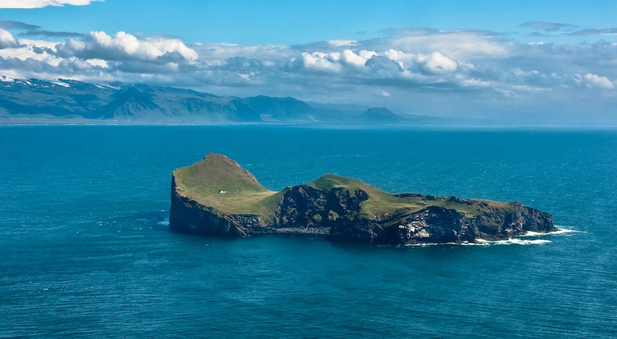
Secluded(V)- “apart” “closed” kept apart or private
Association: What are three synonyms for the word secluded? Write down three.

Slide 16
Using context clues and prior knowledge predict the meaning of the vocabulary word secede.
The first six states to secede held the greatest number of slaves in the South.

Slide 17
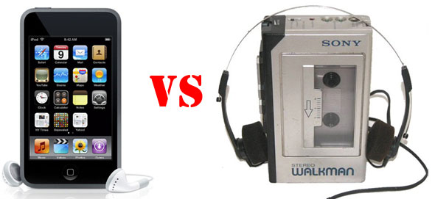
Secede(v)- to break away (usually refers to a country) or replace
Association- Vice Presidents secede Presidents, fashion and technology trends

Slide 18

Tort-Twist

Slide 19
Using context clues and prior knowledge predict the meaning of the vocabulary word contort.
The child’s face contorted when he sucked on a lemon.

Slide 20
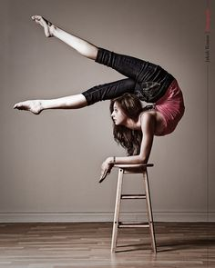
Contort(v)- Twist or bend out of normal shape
Associations:
Dancers
Yoga
Circus Performers

Slide 21
Using context clues and prior knowledge predict the meaning of the vocabulary word retort.
The opposing player retorted the referee’s call and was kicked out of the game.

Slide 22

Retort(v)- to say something or respond in a sharp, disrespectful way
Associations: Sarcasm/Ridicule

