Slide 1
Culp, Clam, Cogn, Chron
Quarter II, Section II

Slide 2
Cogn- Know

Slide 3
Context Clue
Context Clues: Using your knowledge of the root and the surrounding words; what does cognizant mean?
To be a police officer you must be cognizant of your surroundings.

Slide 4
Cognizant- having knowledge or being aware of part of Speech: Adjective
Association/Leaf- Write down three synonyms: Aware, observant, informed

Slide 5
Context Clue
Context Clues: Using your knowledge of the root and the surrounding words; what does incognito mean?
Even celebrities who go out incognito will still get recognized by the public.

Slide 6
Incognito- hiding your identity so you are not known in- not, cogn- known Part of Speech: Adjective
Association/Leaf- ninjas, culprits, superheroes

Slide 7
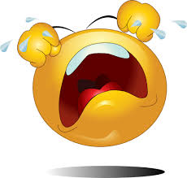
Clam- Cry out

Slide 8
Context Clue
Context Clues: Using your knowledge of the root and the surrounding words; what does clamorous mean?
The clamorous crowd tried to distract the kicker before taking the field goal.

Slide 9
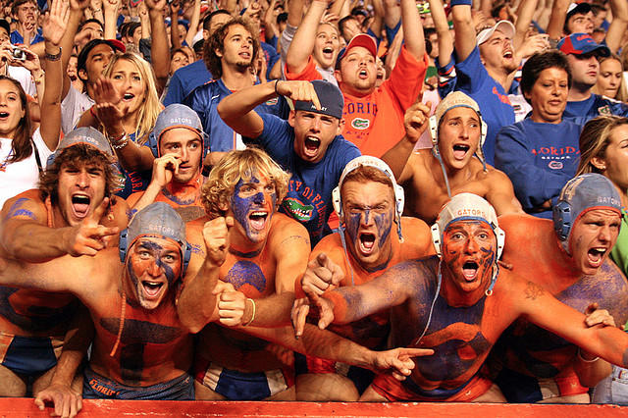
Clamorous- making loud and confused noises
Part of Speech: Adjective
Association/Leaf- Write down synonyms: Loud, Vociferous, Vehement

Slide 10
Context Clue
Context Clues: Using your knowledge of the root and the surrounding words; what does exclaim mean?
“I don’t understand the material!” the student exclaimed.

Slide 11
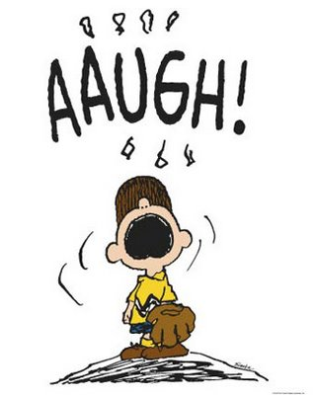
Exclaim- To cry out suddenly out of anger, pain, or excitement
Part of Speech: Verb
Association/Leaf- Write down three synonyms: Shout, Yell, Declare

Slide 12
Culp- Blame

Slide 13
Context Clues: Using your knowledge of the root and the other words in the sentence; figure out what the underlined word means.
The severe drought is the culprit behind the death of the orange trees.

Slide 14
Culprit- person responsible or to blame for a crime
Part of Speech: Noun
Association/Leaf: Handcuffs, Jail bars, Antagonists

Slide 15
Context Clues: Using your knowledge of the root and the other words in the sentence; figure out what the underline word means.
The defendant is culpable for her actions.

Slide 16
Culpable-deserving blame “Blame”-able Part of speech- Adjective Associations: Criminals

Slide 17
Chron- Time

Slide 18
Context Clues: Using your knowledge of the root and the other words in the sentence; figure out what the underline word means.
The novel was difficult to understand because it wasn’t written in chronological order.

Slide 19
Chronological- time order Part of speech: Adjective
Association/Leaf- History, Social Studies

Slide 20
Context Clues: Using your knowledge of the root and the other words in the sentence; figure out what the underline word means.
The retired athlete suffered from chronic aches and pains.

Slide 21
Chronic- Persisting for a long time Part of speech: Adjective
Association/Leaf- Constant, Ceaseless, Persistent

