Slide 1
Quarter 2 List 1
Pug, Acr, Greg, Pac

Slide 2
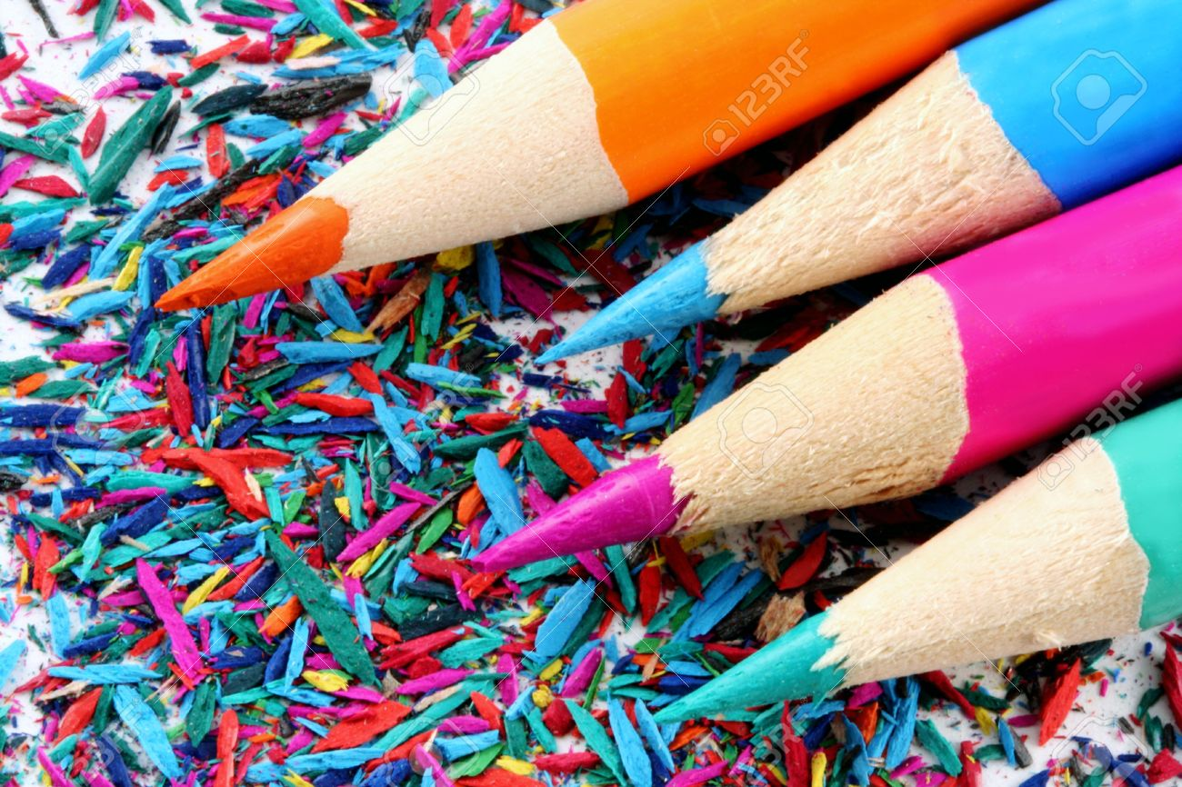
Acr- Sharp

Slide 3
Context Clues: Using your knowledge of the root and the surrounding words; what does acrid mean?
The tree produces excellent timber, and is much used for furniture, its strong acrid taste driving away insects.

Slide 4
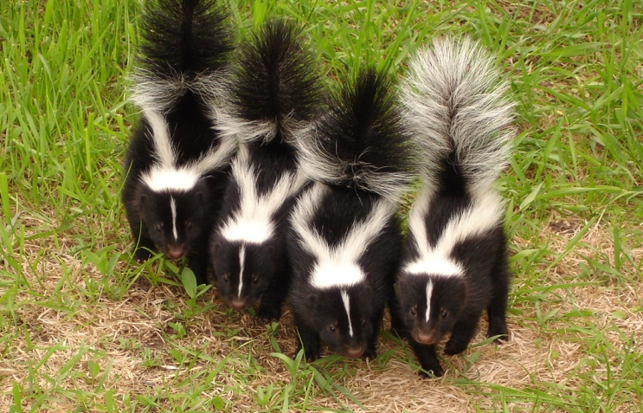
Acrid-(Adj) sharp or biting to the taste or smell

Slide 5
Context Clues: Using your knowledge of the root and the surrounding words; what does acrimonious mean?
He didn't have to explain how accusing his opponent would be perceived, especially after their acrimonious debate.

Slide 6
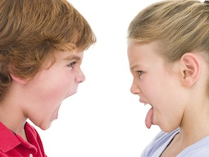
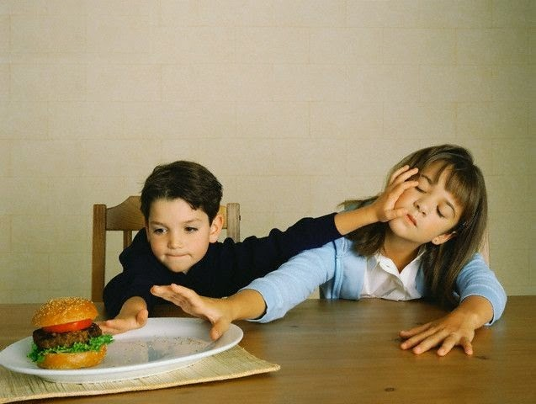
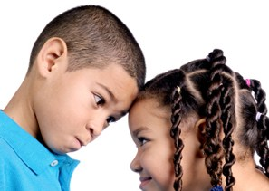
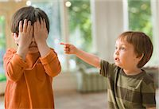
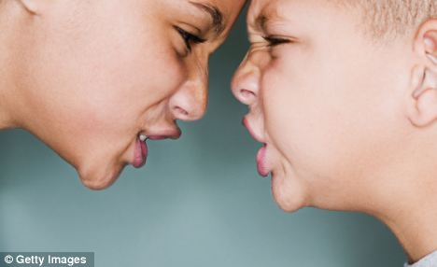
Acrimonious (ADJ)
Acr- Sharp
Ous- full of
Stinging or biting (sharp) in nature, speech, or behavior

Slide 7
Pac- Peace

Slide 8
Context Clues: Using your knowledge of the root and the surrounding words; what does pacify mean?
Their efforts to pacify the nation by force failed.

Slide 9
Pacify- (V) to bring peace
Association: Yoga, meditation, pacifiers

Slide 10
Context Clues: Using your knowledge of the root and the surrounding words; what does gregarious mean?
The charge of pacifism was often brought against him.

Slide 11
Pacifism- (N)
Pac- peace
Ism-doctrine (belief)
the belief and practice of peace. War and violence in unjustifiable
Association: sit ins, fasting, Gandhi

Slide 12
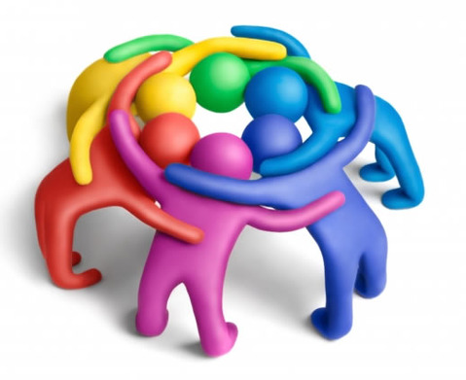
Greg-Group

Slide 13
Context Clues: Using your knowledge of the root and the surrounding words; what does gregarious mean?
If you want to be more approachable, show a gregarious smile.

Slide 14
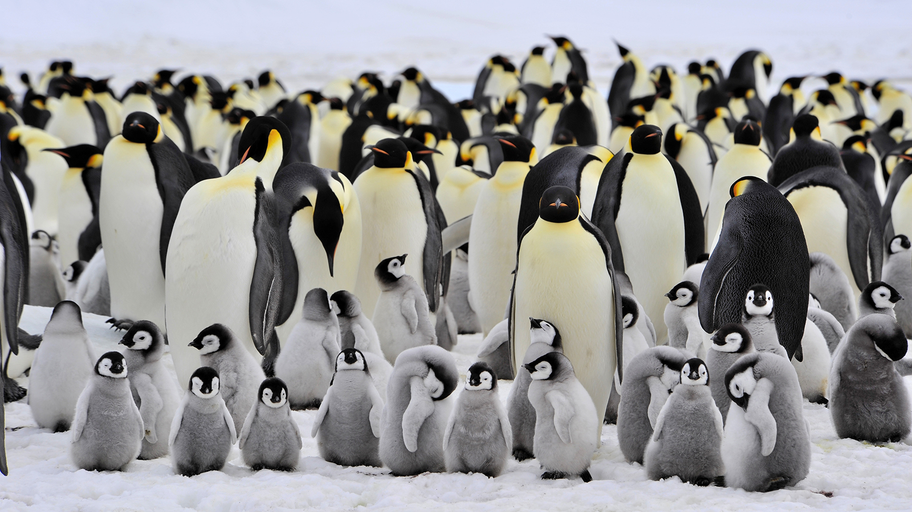
Gregarious-(adj) fond of company; sociable.

Slide 15
Context Clues: Using your knowledge of the root and the surrounding words; what does congregate mean?
During the summer teenagers often congregate at the beach.

Slide 16
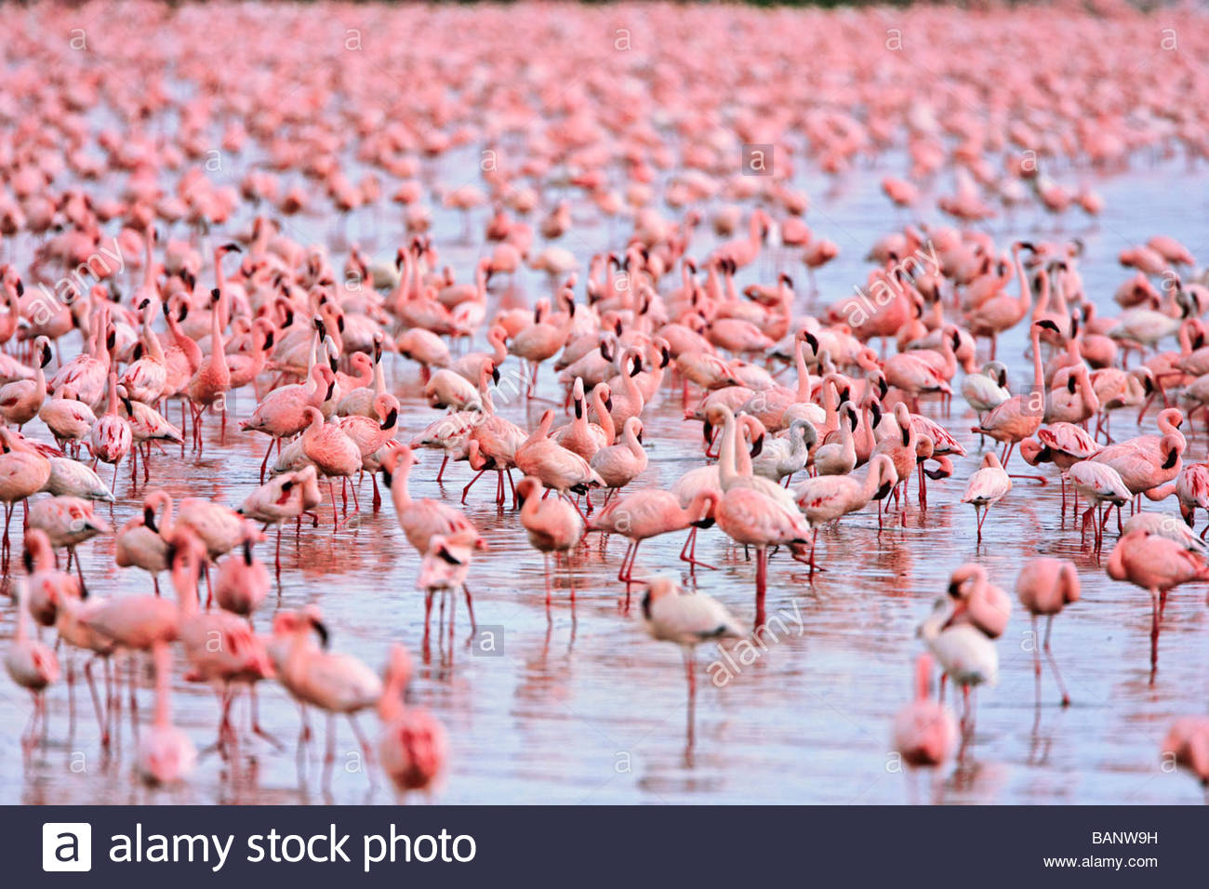
Congregate-(V)to come together

Slide 17
Context Clues: Using your knowledge of the root and the surrounding words; what does segregate mean?
The civil rights movement fought against practices that segregated blacks and whites.

Slide 18
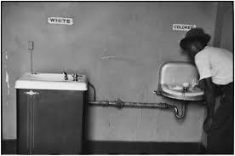
Segregate-(V) to separate or set apart from others or from the general mass :isolate

Slide 19
Pugn- Fight

Slide 20
Context Clues: Using your knowledge of the root and the surrounding words; what does pugnacious mean?
There's one pugnacious member on the committee who won't agree to anything.

Slide 21
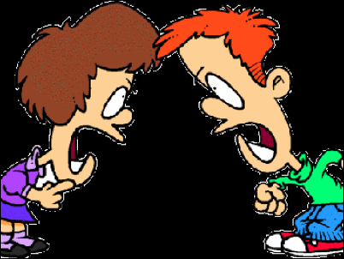
Pugnacious (Adj)
Pugn- fight
Ous- full of
Eager or quick to argue or fight
Association: Students and nephews

Slide 22
Context Clues: Using your knowledge of the root and the surrounding words; what does repugnant mean?
The children’s decision in “The Veldt” by Ray Bradbury to kill their parents was very repugnant.

Slide 23
Repugnant- (Adj) offensive or antagonistic
Association: Rotten eggs, skunks, disrespectful behavior

Slide 24
Vocabulary Homework-Choices
Create a crossword using at least nine words AND provide answers
Helpful Website to create a crossword
http://puzzlemaker.discoveryeducation.com/CrissCrossSetupForm.asp
Write a paragraph using at least 9 words
Create a fill-n-blank worksheet using at least 9 words

