Slide 1
Ism, Dyna, Dign, Fort
Quarter II, Section III

Slide 2
4. Ism- Doctrine (belief)

Slide 3
Using context clues and prior knowledge predict the meaning of the vocabulary word pacifism.
Nelson Mandela’s belief in pacifism made him the most influential leader in South Africa’s history.

Slide 4
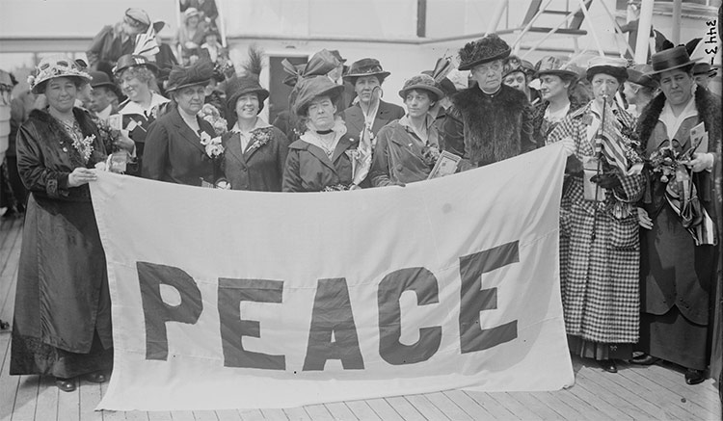
Pacifism- belief of settling conflicts peacefully Part of Speech: Noun (abstract)
Association/Leaf-Nelson Mandela , Martin Luther King Jr.

Slide 5
Using context clues and prior knowledge predict the meaning of the vocabulary word Activism .
By appearing in the commercial, the president hopes to increase voter activism in national elections.

Slide 6
Activism- the belief in supporting an issue Part of Speech: Noun (abstract)
Association/Leaf- What cause would you be an activist for?

Slide 7
Dyna- Power

Slide 8
Using context clues and prior knowledge predict the meaning of the vocabulary word Dynasty.
In history, we learned about a dynasty that ruled Egypt for hundreds of years.

Slide 9
Dynasty- sequence of rulers from the same family Part of speech: Noun
Association/Leaf- Mulan, Chinese Government

Slide 10
Using context clues and prior knowledge predict the meaning of the vocabulary word Dynasty.
Dynamic teachers are capable of being flexible with their lesson plans.

Slide 11
Dynamic- constant change, activity, progress Part of speech: Adjective
Association/Leaf- Protagonists

Slide 12
Dign- Worthy

Slide 13
Using context clues and prior knowledge predict the meaning of the vocabulary word Dignify.
The student wouldn’t dignify the bully’s comments by responding to them.

Slide 14
Dignify- to make something seem worthy or impressive Part of Speech: Action Verb
Association: What are three synonyms for DIGNIFY?

Slide 15
Using context clues and prior knowledge predict the meaning of the vocabulary word Indignant.
The indignant student rolled their eyes at the teacher.

Slide 16
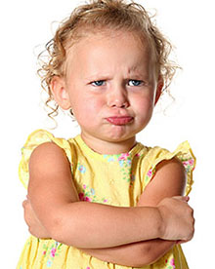
Indignant- feeling or showing anger because you believe to be treated unfairly Part of Speech: Adjective
Association/Leaf: What are three synonyms for indignant?

Slide 17
Fort- Strong

Slide 18
Using context clues and prior knowledge predict the meaning of the vocabulary word Fortify.
Getting 8 hours of sleep, eating healthy, and exercising are great ways to fortify your body.

Slide 19
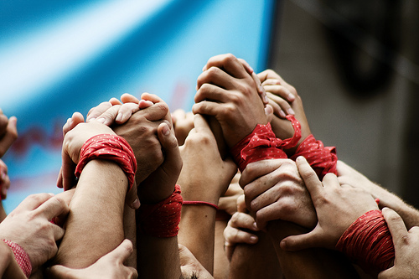
Fortify- to make strong
Fort= strong
fy-= make
Part of Speech: Action Verb
Association: What are 3 synonyms for fortify?

Slide 20
Using context clues and prior knowledge predict the meaning of the vocabulary word Fortitude.
The student showed fortitude by not giving into peer pressure and remaining strong in their beliefs.

Slide 21
Fortitude- strength of mind Part of Speech: Abstract noun
Association/Leaf: Draw a brain with strong muscles (weird I know)

