Slide 1
Adjectives

Slide 2
What is an adjective?

Slide 3
What is an adjective?
Adjectives MODIFY nouns or pronouns.

Slide 4
What is an adjective?
Adjectives MODIFY nouns or pronouns.
Modify is a synonym for DESCRIBE

Slide 5
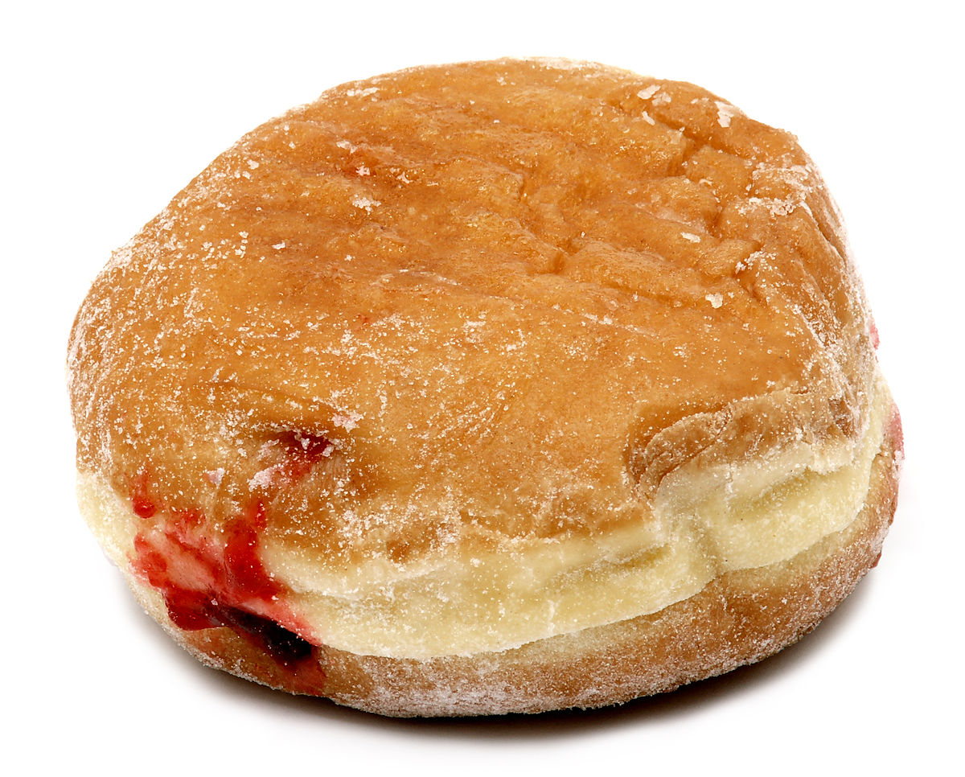
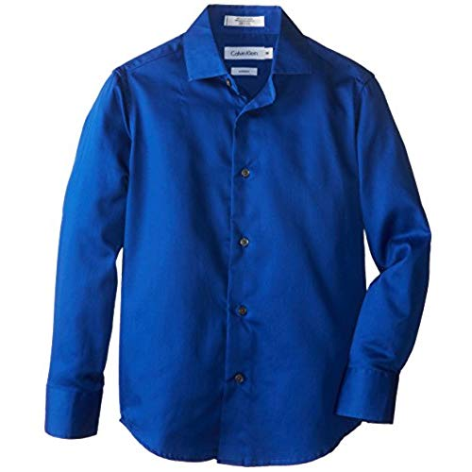
What is an adjective?
Adjectives MODIFY nouns or pronouns.
Modify is a synonym for DESCRIBE
Ask the questions:
* How many?/How much?
* What kind?
* Which one?

Slide 6
ARticles
ARTICLES ARE ADJECTIVES!
Defines nouns specifically or unspecifically.
A, an, the
Definite – The
Indefinite- A, an

Slide 7
What is a Proper adjective?

Slide 8
What is a Proper adjective?
Proper Adjectives are specific adjectives that begin with a capital letter
Example?

Slide 9
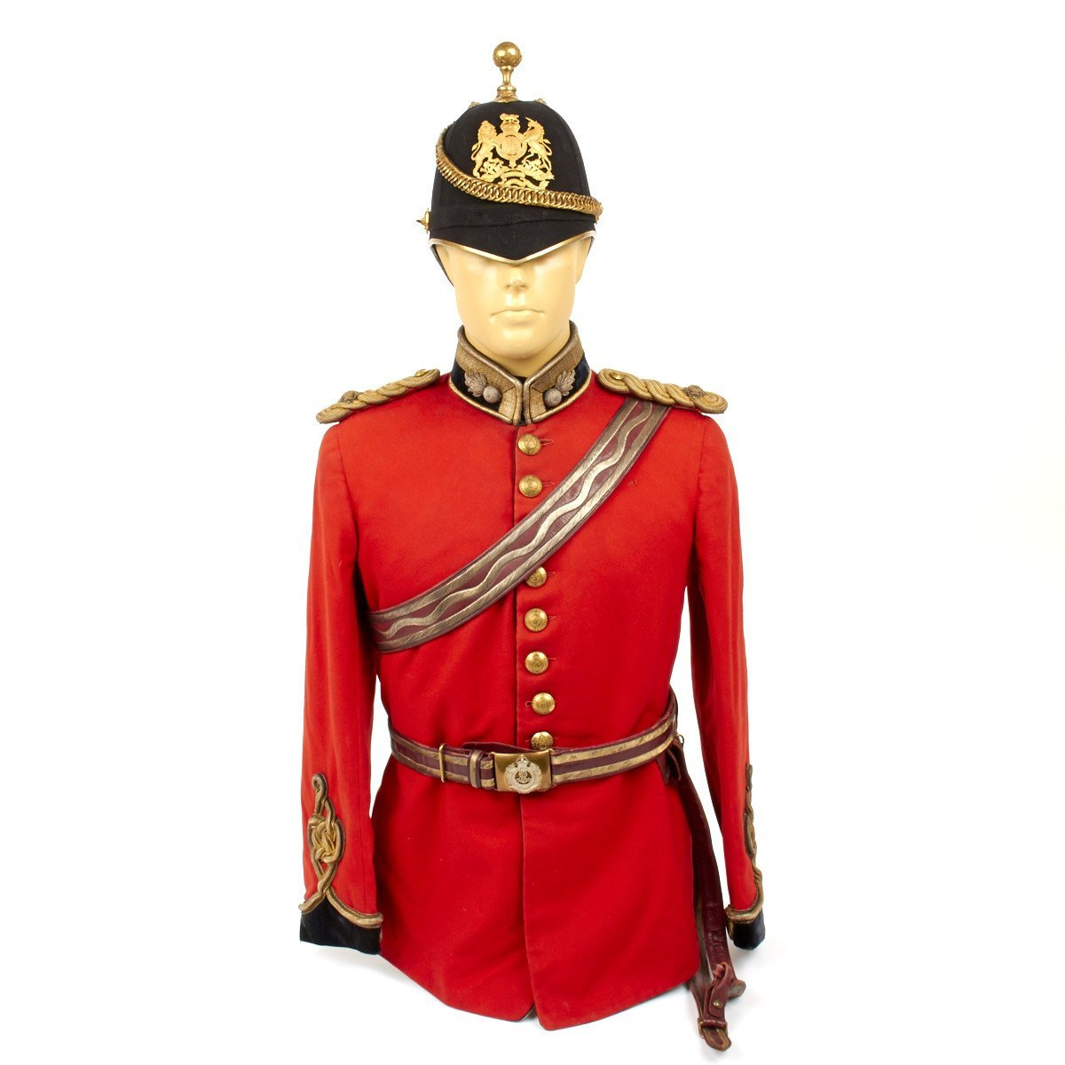
What is a Proper adjective?
Proper Adjectives are specific adjectives that begin with a capital letter
Example-British uniform

Slide 10
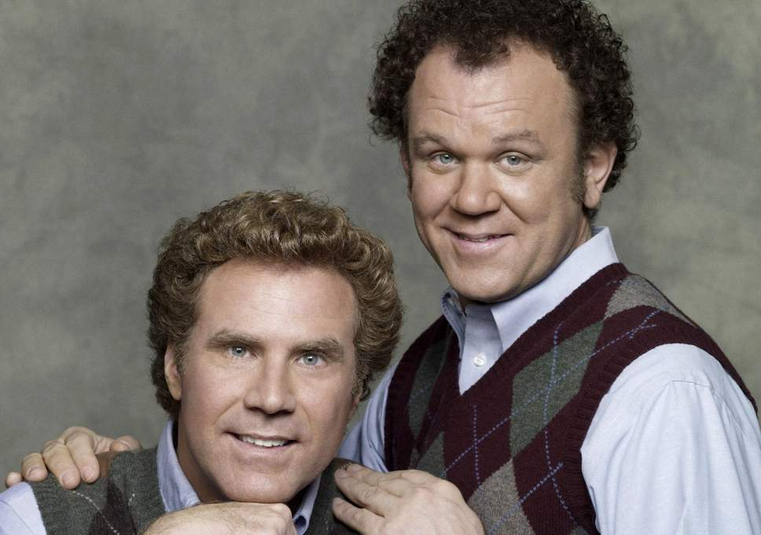
Comparative Adjective
Compares 2 nouns
Examples:
Old, older
Thin, thinnest
Nice, Nicer
Brennan is old, but his brother is older.

Slide 11
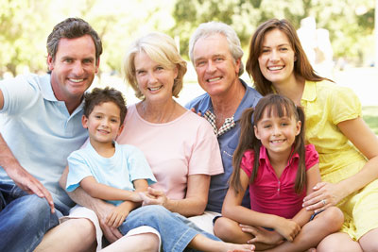
Superlative Adjective
The best, worst, or extreme adjective.
Example: Tallest, smallest, fastest, highest.
It compares 3 or more nouns.
Teddy is the oldest in his family.
It was the best of times, it was the worst of times.
-A Tale of Two Cities

