Slide 1
4th Quarter Roots

Slide 2
What is the purpose of Greek and latin?
Know one root, know many words
Know one suffix, know part of speech
Know one prefix, know definition
Know roots, strengthen reading ability
Know vocabulary, strengthen writing ability

Slide 3
Nym, Ego, Prim, Apt
Section 4, Set 1

Slide 4
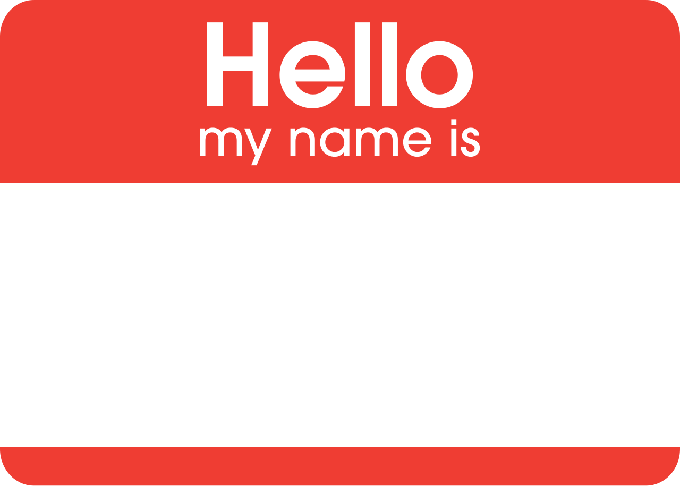
Nym-Name

Slide 5
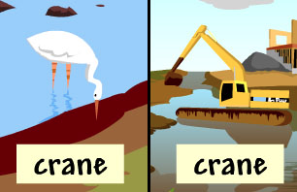
Homonym (Noun)- Same Name (same spelling and pronunciations but different meanings)
Come up with 5 pairs of homonyms! (Double Denotation)

Slide 6
Using context clues and prior knowledge predict the meaning of the vocabulary word Pseudonym.
"Geisel was best known by the pseudonym 'Dr. Seuss'"

Slide 7
Pseudonym (Abstract Noun)- False or fake name
Association: Write down what your pseudonym would be.

Slide 8
Ego- I

Slide 9
Using context clues and prior knowledge predict the meaning of the vocabulary word egotistical.
"Archie's egotistic lifestyle has alienated many people over the years"

Slide 10
Egotistical (adjective)- excessively absorbed in one’s self, self-centered
Association: Draw a stick figure with the universe revolving around the stick figure.

Slide 11
Using context clues and prior knowledge predict the meaning of the vocabulary word Alter ego.
Clark Kent and his alter ego Superman.

Slide 12
Alter Ego (noun)- the other Self
Association/Leaf- Clark Kent to Superman, Peter Park to Spiderman

Slide 13
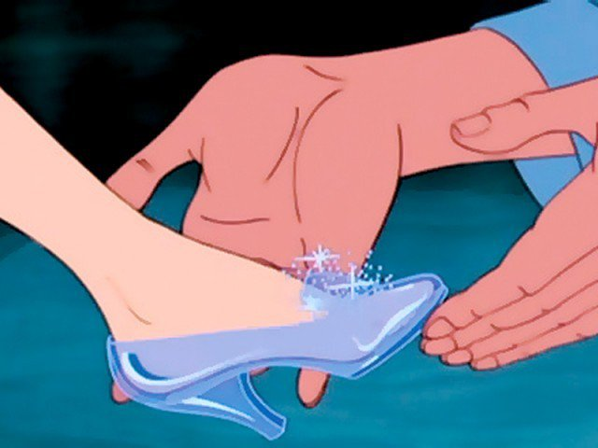
Apt- Fit

Slide 14
Using context clues and prior knowledge predict the meaning of the vocabulary word Adapted.
The miniseries was adapted from novel.

Slide 15
Adapt (action verb)- to make something suitable (fittable) for a new use or purpose
Association: (Science) what kind of mammals, amphibians must adapt to their environment?

Slide 16
Using context clues and prior knowledge predict the meaning of the vocabulary word Aptitude .
“He had a remarkable aptitude for learning words.”

Slide 17
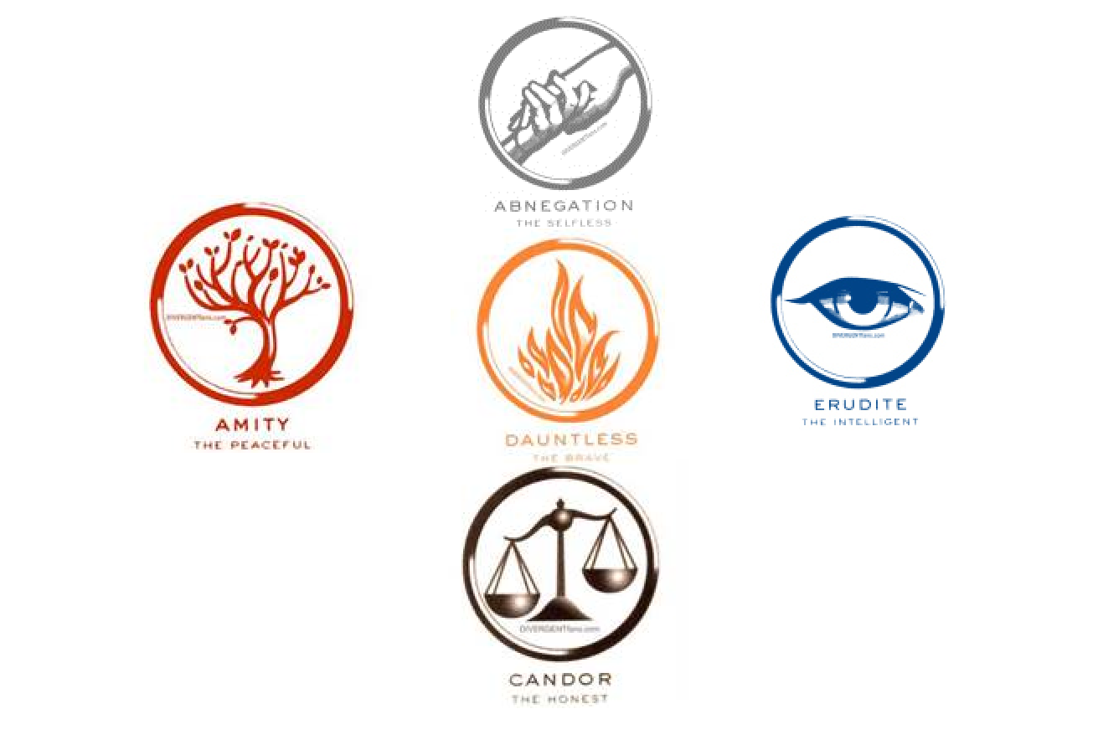
Aptitude (Abstract noun)- a specific fitness or skill
Association- I have an aptitude for . . .

Slide 18
Prim- First

Slide 19
Primary(adjective)- the most important or earliest time or development

Slide 20
Using context clues and prior knowledge predict the meaning of the vocabulary word Primary .
Our primary role as students is to learn, grow, and help others.

Slide 21
Prime (adjective)- of most importance
Association: Synonyms Chief, Key, Principal

Slide 22
Using context clues and prior knowledge predict the meaning of the vocabulary word Prime.
Ms. Snowdon and Mrs. Grow are in the prime of their lives.

