Slide 1
4th Quarter Roots

Slide 2
What is the purpose of Greek and latin?
Know one root, know many words
Know one suffix, know part of speech
Know one prefix, know definition
Know roots, strengthen reading ability
Know vocabulary, strengthen writing ability

Slide 3
Grading Policy
Copying down the root stem and vocabulary words +1
Copying down all three definitions +1
Writing down parts of speech +1
Drawing/creating leaves +1
Highlighting the root stems in the vocabulary words +1
Total= 5 points per tree x 4 trees = 20 points total

Slide 4
Luc, Rupt, Trib, Thermo
Section 4, Set 3

Slide 5
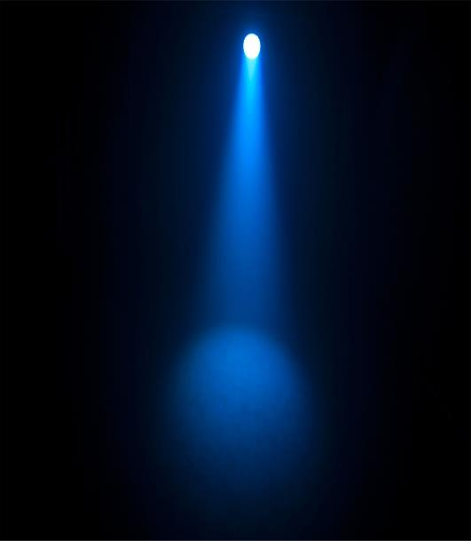
Luc-light

Slide 6
Using context clues and prior knowledge predict the meaning of the vocabulary word Translucant.
It almost appeared as though I could see through the translucent scales of the unusual fish.

Slide 7
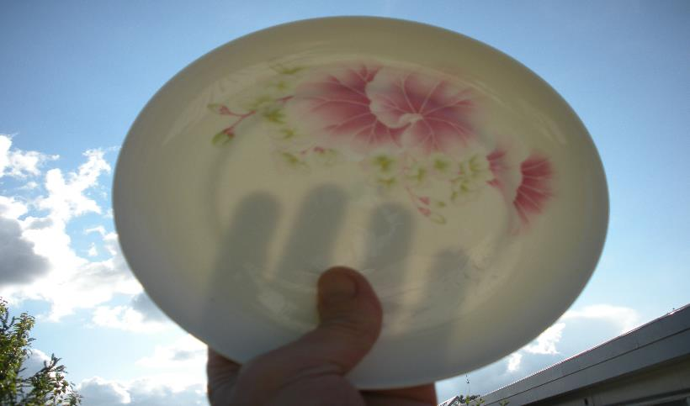
Translucent- (adj) (of a substance) allowing light, but not detailed images, to pass through; semitransparent
Association/Leaf- What objects can you think of that are translucent?

Slide 8
Using context clues and prior knowledge predict the meaning of the vocabulary word Lucid.
Because the medicine made Lisa drowsy, she was not very lucid.

Slide 9
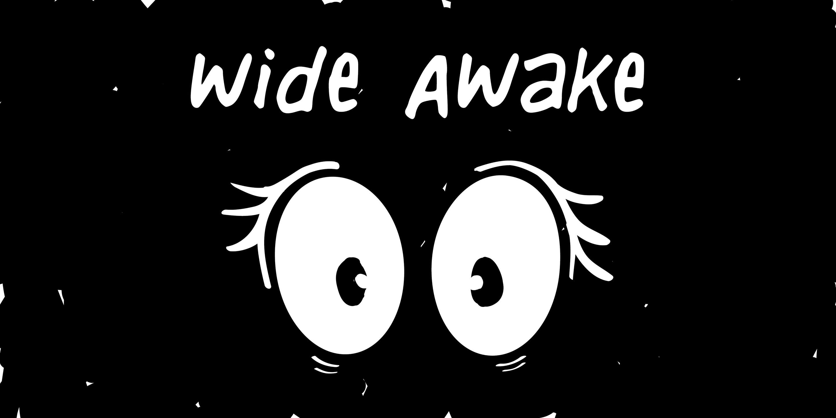
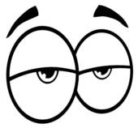
Lucid- (adj)expressed clearly; easy to understand.
Association/Leaf- when are you most lucid throughout the day?

Slide 10
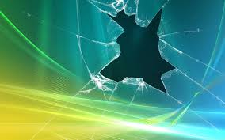
Rupt- break

Slide 11
Using context clues and prior knowledge predict the meaning of the vocabulary word Corrupt.
His eldest son was incapable, haughty and exceedingly corrupt.

Slide 12
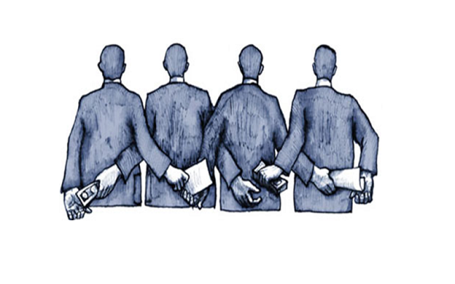
Corrupt- (adj.) having or showing a willingness to act dishonestly in return for money or personal gain.

Slide 13
Using context clues and prior knowledge predict the meaning of the vocabulary word Abrupt.
He caught her arm, bringing her to an abrupt halt.

Slide 14
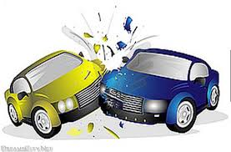
Abrupt- (adj.) sudden and unexpected.
Association/Leaf- accidents, cliff hangers, mysteries

Slide 15
Trib-Pay

Slide 16
Using context clues and prior knowledge predict the meaning of the vocabulary word Contribute.
I want someone who can contribute intelligent conversation, not grovel at my feet.

Slide 17
Contribute (verb)- help to a cause or group
Association: Group projects, charities, organizations

Slide 18
Using context clues and prior knowledge predict the meaning of the vocabulary word Attribute.
Carl is such a horrible person I can’t list one positive attribute that describes him.

Slide 19
Attribute (N)- a characteristic of someone
Association: Complete the statement: “My best attribute to the class is ____”

Slide 20
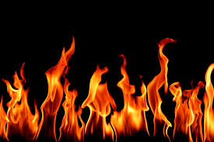
Thermo-Heat

Slide 21
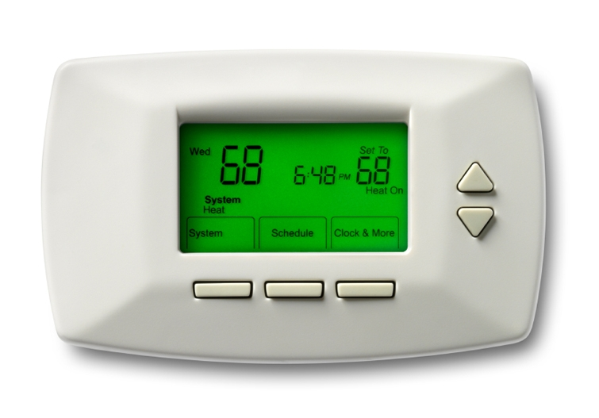
Thermostat (N)-a device that automatically regulates temperature/heat
Association –Winter

Slide 22
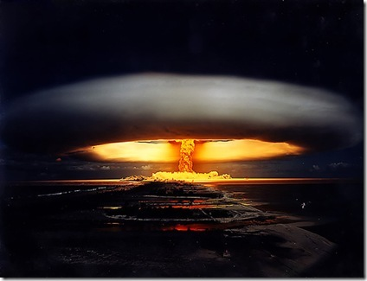
Thermonuclear (adj)-elating to or using nuclear reactions that occur only at very high temperatures.
Association –What country is the US worried about using thermonuclear devices?

Slide 23
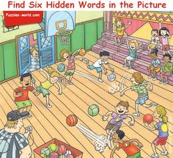
Assignment
Choose ONE:
Draw a picture with the words hidden in the picture
Use at least SIX words
Crossword
Have at least TEN clues

