Slide 1
4th Quarter Roots

Slide 2
What is the purpose of Greek and latin?
Know one root, know many words
Know one suffix, know part of speech
Know one prefix, know definition
Know roots, strengthen reading ability
Know vocabulary, strengthen writing ability

Slide 3
Grat, Sanct, Anim, Sens
Section 4, Set 2

Slide 4
Grat- pleasing

Slide 5
Using context clues and prior knowledge predict the meaning of the vocabulary word Gratitude.
This gratitude reminded Ms. Snowdon of how much she loves to teach.

Slide 6
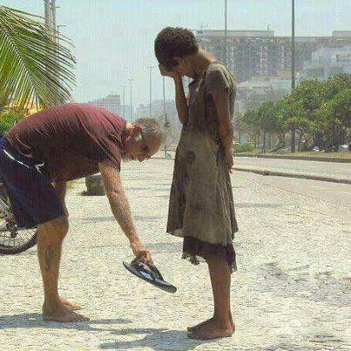
Gratitude- (abstract noun) the quality of being thankful; readiness to show appreciation for and to return kindness.
Association/Leaf- What do you have gratitude for?

Slide 7
Using context clues and prior knowledge predict the meaning of the vocabulary word Ingrate.
The bride was an ingrate who did not send out thank-you notes for her wedding presents.

Slide 8
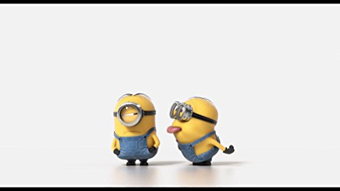
Ingrate- (Noun) an ungrateful person
Association/Leaf –Who in your life is sometimes an ingrate?

Slide 9
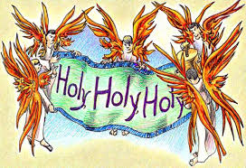
Sanct-holy

Slide 10
Using context clues and prior knowledge predict the meaning of the vocabulary word Sanctified.
The priest sanctified their marriage.

Slide 11
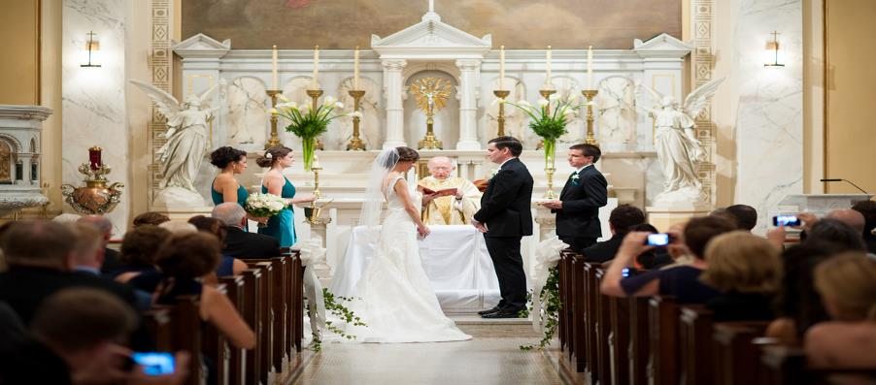
Sanctify (action verb) to make holy; set apart as sacred.
Association: Peace Signs, Thumbs up, Okay

Slide 12
Using context clues and prior knowledge predict the meaning of the vocabulary word Sanctuary.
The house was a sanctuary for runaway teens.

Slide 13
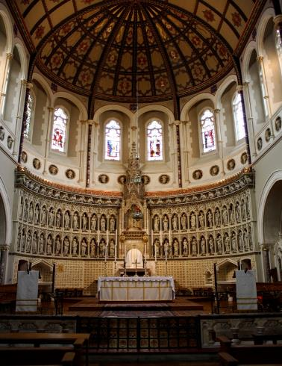
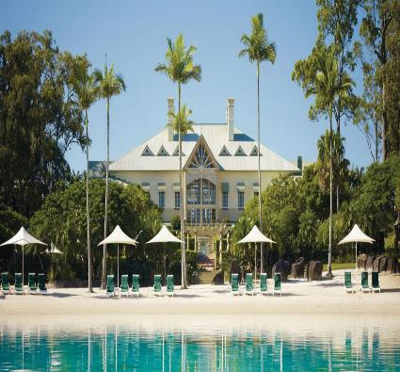
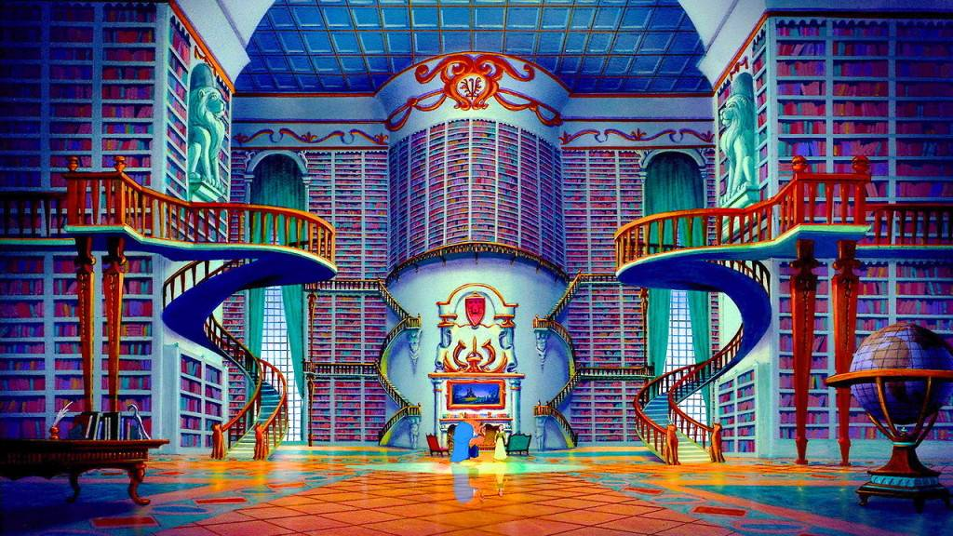
Sanctuary- (Concrete Noun) a place of refuge or safety or holiness
Association: Where is your sanctuary?

Slide 14
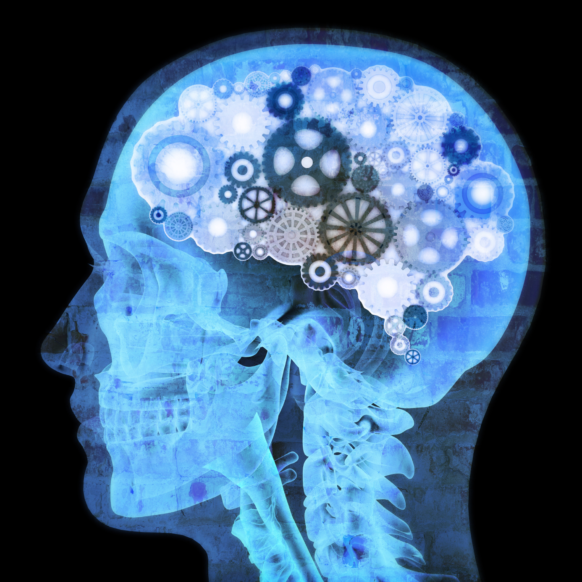
Anim- Mind

Slide 15
Using context clues and prior knowledge predict the meaning of the vocabulary word Animosity.
Few rivalries can match that of the Cards and Cubs in terms of history, color and animosity.

Slide 16
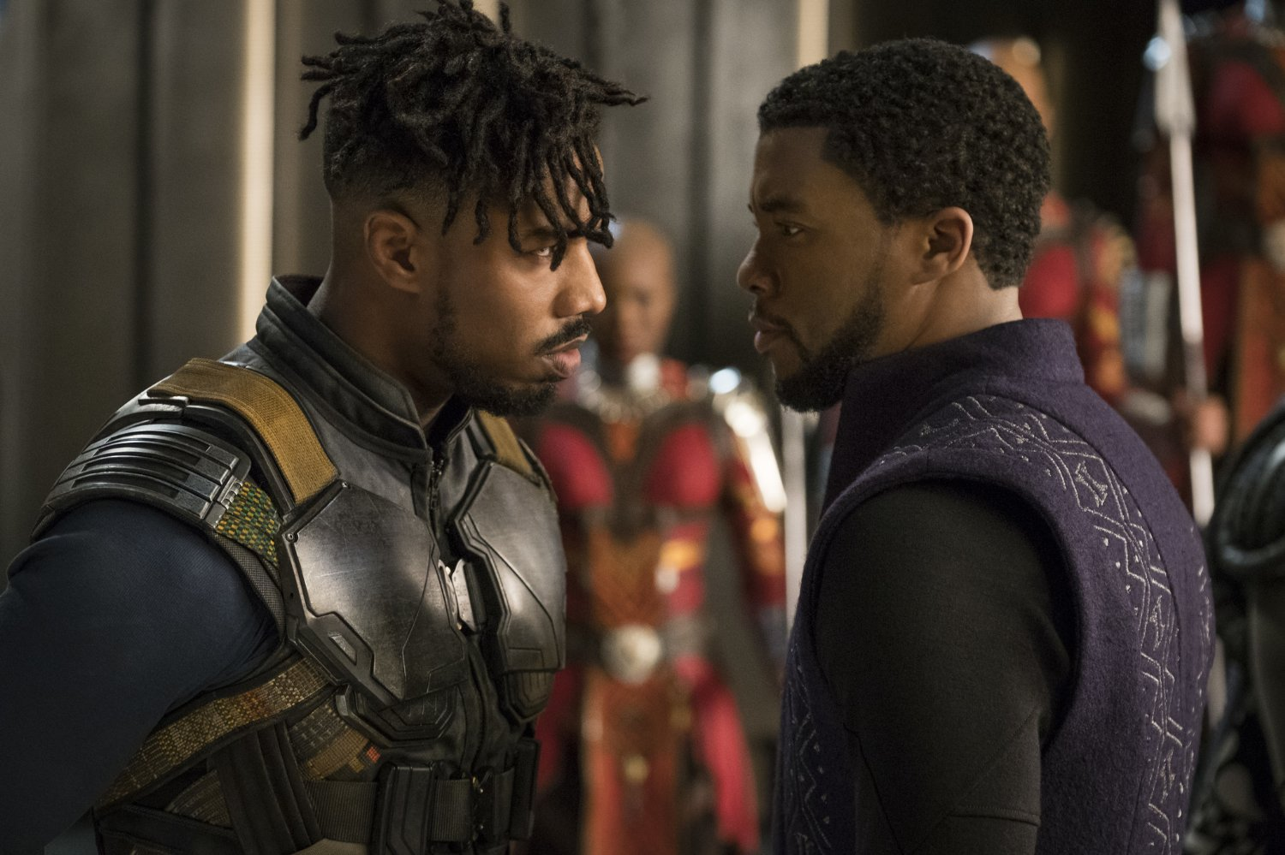
Animosity (abstract noun)- strong hatred
Association- Enemies

Slide 17
Using context clues and prior knowledge predict the meaning of the vocabulary word Animated.
After dinner, the discussion got more animated.

Slide 18
Animated- (adjective) Full of life, excitement
Association: Mr. Oldfield

Slide 19
Sens- Feel

Slide 20
Using context clues and prior knowledge predict the meaning of the vocabulary word Sensation.
She had the strange sensation that someone was watching her.

Slide 21
Sensation- n. a physical feeling or perception
Association: When do you get goosebumps?

Slide 22
Using context clues and prior knowledge predict the meaning of the vocabulary word Insensate.
The insensate boss refuses to allow time off for funerals.

Slide 23
Insensate- adj. lacking sympathy or compassion; unfeeling
Associations: Synonyms- callous, indifferent hardened

Slide 24
Homework
Create a crossword that has at least 10 clues
I like to use http://puzzlemaker.discoveryeducation.com/CrissCrossSetupForm.asp
You must copy the crossword and then the clues onto a Google Doc to turn into Google Classroom
You may create a crossword on paper and turn into the substitute

