Slide 1
Greek and Latin Roots
Quarter 1-List 1

Slide 2
What is the purpose of Greek and latin?
Know one root, know many words
Know one suffix, know part of speech
Know one prefix, know definition
Know roots, strengthen reading ability
Know vocabulary, strengthen writing ability

Slide 3
Vita- Life

Slide 4
Using Knowledge of the root and context clues what is the definition of Vitality.
Even at age ninety-three, my grandfather was full of vitality.

Slide 5
Vitality- state of being strong and active Parts of Speech: Noun
Association/Leaf- 7th graders, my nephew Connor

Slide 6
Using Knowledge of the root and context clues what is the definition of Vital.
The heart and lungs are vital organs.

Slide 7
Vital- absolutely necessary; important Part of Speech: Adjective
Association/Leaf- What are some examples of things that are vital for us to live?

Slide 8
Cle- Small

Slide 9
Molecule- smallest particle in a chemical element
Part or Speech: Noun
Chemistry

Slide 10
Using Knowledge of the root and context clues what is the definition of minuscule.
The chance of winning the lottery is unfortunately minuscule.

Slide 11
Part of Speech: adjective
Miniscule- extremely tiny
Association/Leaf: Insects, atoms, cells

Slide 12
Scope-look

Slide 13
Using Knowledge of the root and context clues what is the definition of Telescope.
He certainly describes a method of constructing a telescope, but not so as to lead one to conclude that he was in possession of that instrument.

Slide 14
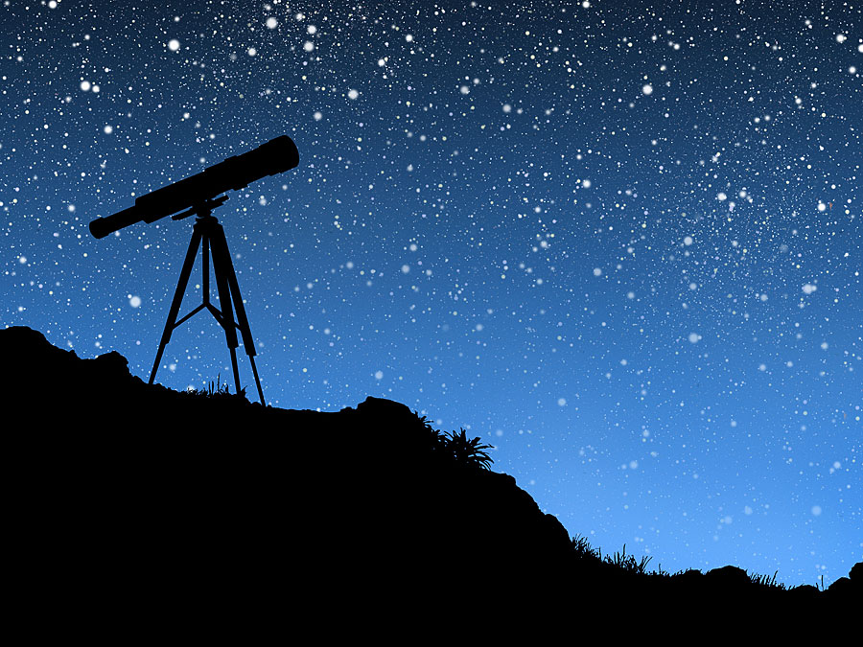
telescope- instrument designed to make distant objects appear nearer Part of Speech: noun
Association Leaf- To see the Blood Moon, Astronomy

Slide 15
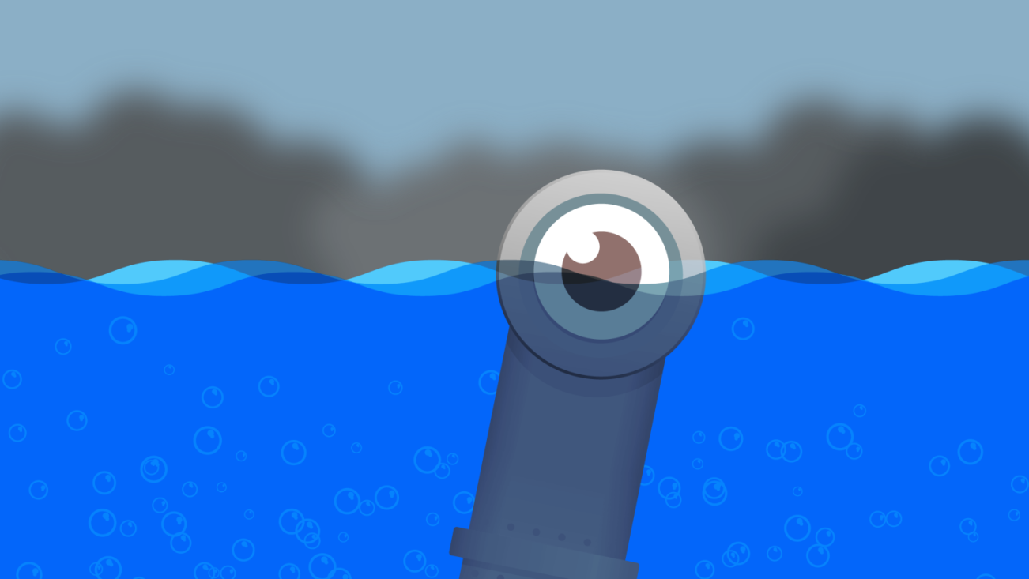
periscope-a machine so can see things that are otherwise out of sight. Part of Speech: noun
Association/Leaf- Submarine

Slide 16
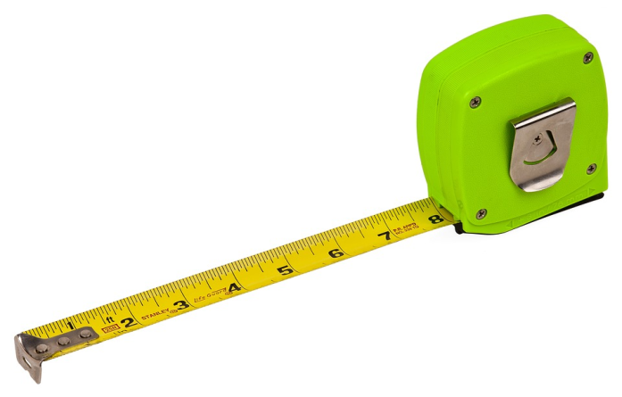
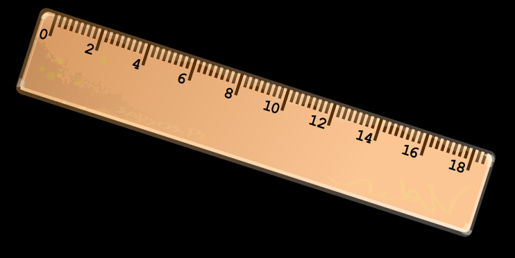
Meter-Measure

Slide 17
Using Knowledge of the root and context clues what is the definition of thermometer.
There is no place in Russia, Archangel and Astrakhan included, where the thermometer does not rise in summer nearly to 86° Fahrenheit.
Predictions-What words helped you come to that conclusion? Background Knowledge?

Slide 18
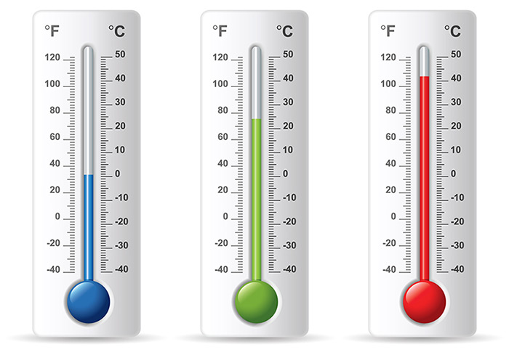
Thermometer-an instrument for measuring and indicating temperature Part of Speech: Noun
Association –Weather

Slide 19
Using Knowledge of the root and context clues what is the definition of odometer.
Dean looked at the odometer and then at the mileage log.
Predictions-What words helped you come to that conclusion? Background Knowledge?

Slide 20
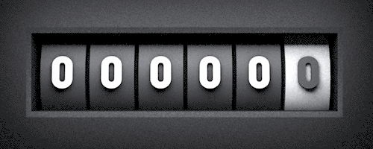
Odometer-an instrument for measuring the distance traveled by a vehicle. Part of Speech: Noun
Association –gas mileage

