Slide 1
Il, Leg, Voc, Rid
Quarter I, Section 3

Slide 2
Il-not

Slide 3
Illiterate- Not able to read or write Part of Speech: Adjective
Association/Leaf- Draw a book with an X over it.

Slide 4
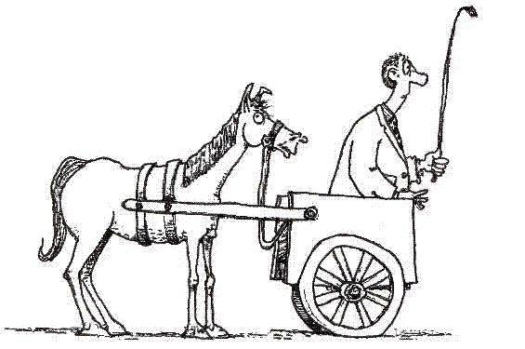
Illogical- not making sense or without reason Part of speech: Adjective
ASSOCIATION/LEAF- DRAW A BRAIN WITH A X OVER IT

Slide 5
Leg- Read

Slide 6
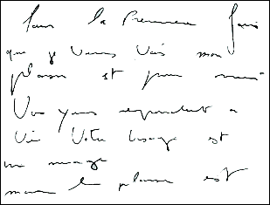
Illegible- not clear enough to be read
Part of speech: Adjective
Association/Leaf: Doctor’s notes, student handwriting,

Slide 7
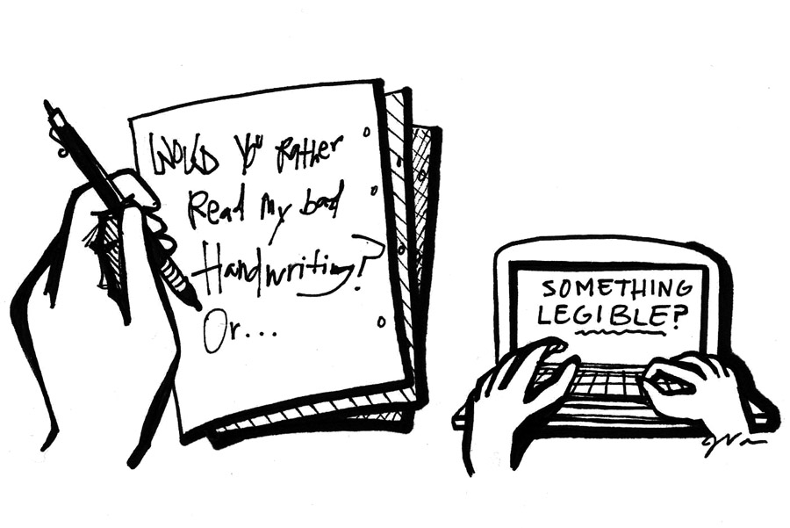
Legible- Clear enough to read
Part of speech: Adjective
Association/leaf: print, typed

Slide 8
Voc- Voice

Slide 9
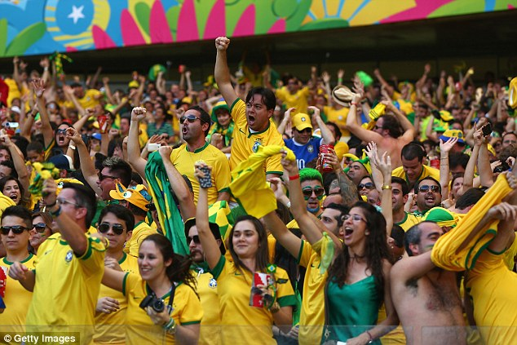
Vociferously- expressing feelings or opinions in a very loud or forceful way
Part of Speech: Adverb
Association/Leaf: Oh man… Sports fans, 7th graders,

Slide 10
Advocate- publically recommend or support a cause Part of Speech: Verb
Association/Leaf- Animal rights, civil rights, environment, education

Slide 11
Rid-Laugh

Slide 12
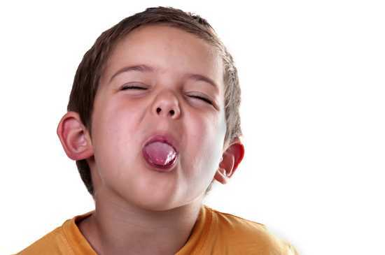
Ridicule- to make fun of
Part of Speech: Verb
Association/Leaf- SNL, Political Cartoons, Comedy Roasts

Slide 13
Ridiculous- deserving to be made fun of, absurd
Part of speech: Adjective
Association/Leaf: Laughable, Absurd, Comical, Amusing

