Slide 1
Tact, Tang, Man, Fy
Quarter 1, Section 2

Slide 2
Tang- Touch

Slide 3
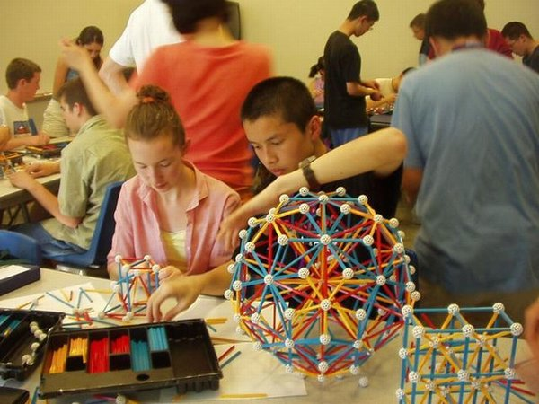
Tangible- perceived or looked at by touch
Part of speech: Adjective
Association/Leaf- Manipulatives, Legos, Play-doh, Models

Slide 4
Intangible- not able to be touched – Part of Speech- Adjective
In- not
Tang-touch
Ible- able
Association/Leaf- ideas (honesty, truth, work-ethic)

Slide 5
Fy- make

Slide 6
Fortify- to make strong
Fort= strong
fy-= make Part of Speech-Verb
Association/Leaf: Armor, Helmets, Nutrition

Slide 7
Rectify- to make (something) right part of Speech- Verb
Associations: Test corrections, apologies

Slide 8
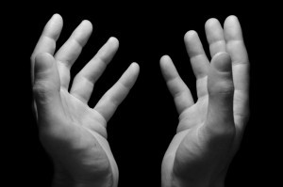
Man-hand

Slide 9
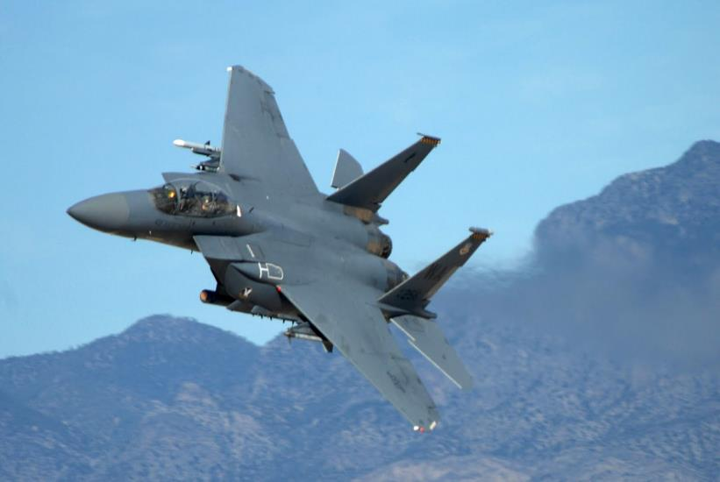
Maneuvering-move skillfully or carefully by hand
Part of speech: Verb
Association: Cars, Remote controls, tools

Slide 10
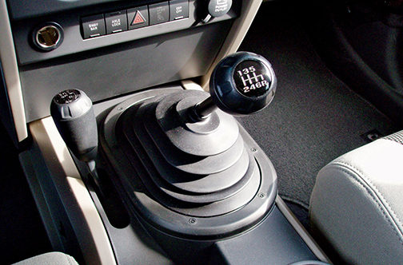
Manuel-operated by the hand or hands rather than by an electronic device
Part of Speech: Adjective
Association: hammer instead of a nail gun

Slide 11
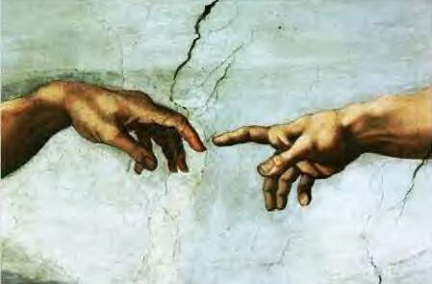
Tact- Touch

Slide 12
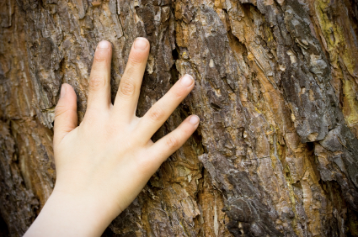
Tactile- connected with the sense of touch, understanding through touch
Part of Speech- Adjective
Association/Leaf: Braille, Kinesthetic learners

Slide 13
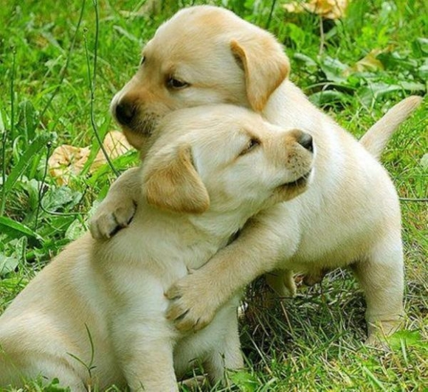
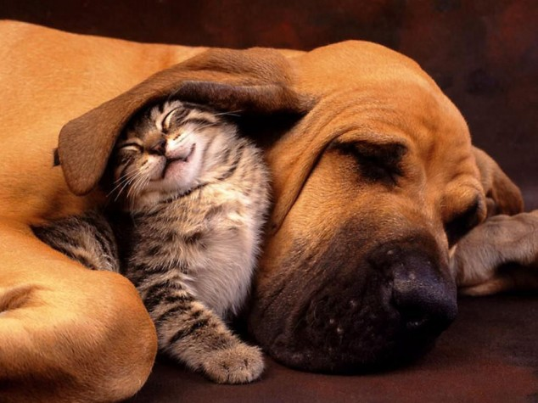
Tactful- having sensitivity in dealing with others
Part of Speech– Adjective
Association/Leaf: Who is the most tactful person in the class? Write the name of the most tactful person in your life.

